Slide 1

JAYA PRAKASH NARAYAN COLLEGE OF ENGINEERING
DEPARTMENT OF COMPUTER SCIENCE ENGINEERING
BACHELOR OF TECHNOLOGY
IN
COMPUTER SCIENCE ENGINEERING
PROJECT PRESENTATION ON -
PREDICTION AND CLASSIFICATION OF THYROID DISEASE USING MACHINE LEARNING
BY-
L.SRI ROOPA(19361A0584)
D.SREEJA(19361A0581)
K.RAHUL SHASHANK(19361A05A1)
B RUKMINI(19361A0563)
T.SAI KUMAR REDDY(18361A0577)
UNDER THE GUIDANCE OF
MS.NAZIA TABBASUM
ASST.PROFESSOR
DEPARTMENT OF COMPUTER SCIENCE ENGINEERING
JPNCE

Slide 2
LIST OF CONTENTS
SLNO | CHAPTER
1 | INTRODUCTION
2 | OBJECTIVE
3 | METHODOLOGY
4 | RESULTS
5 | CONCLUSION AND FUTURE ENHANCEMENT
6 | REFERENCES

Slide 3
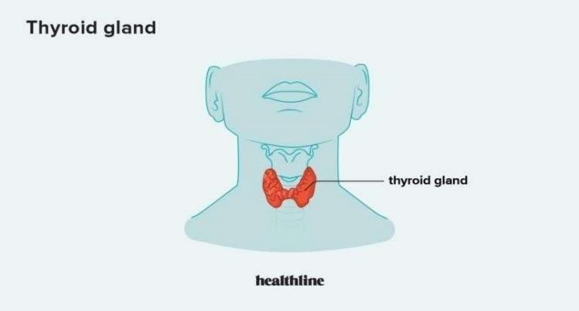
INTRODUCTION
Thyroid is a butterfly-shaped gland, which is located at the bottom of the throat responsible for producing two active thyroid hormones, levothyroxine (T4) and triiodothyronine (T3) that affect some functions of the body such as: stabilizing body temperature, blood pressure, regulating the heart rate etc. Reverse T3 (RT3) is manufactured from thyroxine (T4), and its role is to block the action of T3. An abnormal function of the thyroid implies the occurrence of hyperthyroidism and hypothyroidism, two of the common thyroid affections.
The main factors that affect the thyroid function. It is obvious that factors such as stress, infection, toxins, trauma and certain medication are directly responsible for the improper production of thyroid hormones.

Slide 4
OBJECTIVE
The motivation behind using machine learning for thyroid classification and prediction is to enhance diagnostic accuracy, personalize treatment plans, improve efficiency, enable early detection, and provide valuable insights to support health care professionals in delivering better patient care.
By using machine learning algorithms we can improve the accuracy of prediction of thyroid in the early stages

Slide 5
EXISTING SYSTEM
In existing system, thyroid diseases are more and more spread worldwide. In Romania, for example, one of eight women suffers from hypothyroidism, hyperthyroidism or thyroid cancer. Various research studies estimate that about 30% of Romanians are diagnosed with endemic goiter. Factors that affect the thyroid function are: stress, infection, trauma, toxins, low calorie diet, certain medication etc. It is very important to prevent such diseases rather than cure them, because the majority of treatments consist in long term medication or in chirurgical intervention.
The current study refers to thyroid disease classification in two of the most common thyroid dysfunctions (hyperthyroidism and hypothyroidism) among the population. The authors analyzed and compared four classification models: Decision Tree, Multilayer Perceptron . The results indicate a significant accuracy for all the classification models mentioned above, the best classification rate being that of the Decision Tree model.
Drawbacks :
i. Traditional way of Thyroid detection includes proper examination by medicalexperts.
ii. It can consume more time and its expensive.

Slide 6
PROPOSED SYSTEM
In this system, the thyroid dataset was taken as input. The input data was taken from the dataset repository. Then, data preprocessing step has to be implemented. In this step, have missing values are to be handled for avoid wrong prediction. If there is any missing values in our input data then replace the missing values by zero or Nan values. Next, implement the label encoding for convert the strings into numeric integer value.
Next, data splitting has to be implemented. In this step, splitting the data into test and train is done. Then implement the machine learning algorithms such as Random forest classifier for predicting the disease Finally, the experimental results shows that the performance metrics such as accuracy, precision, recall and f1 score.
Advantages
i. It is efficient for large number of datasets.
ii. Time consumption is low.
iii. The process is implemented with removing the unwanted data.

Slide 7
MODULES
DATA COLLECTION
DATA PREPROCESSING
DATA SPLITTING
MODEL TRAINING

Slide 8
DATASET COLLECTION
Source(Kaggle)
age - age of the patient (int)
sex - sex patient identifies (str)
on_thyroxine - whether patient is on thyroxine (bool)
query on thyroxine - *whether patient is on thyroxine (bool)
on antithyroid meds - whether patient is on antithyroid meds (bool)
sick - whether patient is sick (bool)
pregnant - whether patient is pregnant (bool)
thyroid_surgery - whether patient has undergone thyroid surgery (bool)
I131_treatment - whether patient is undergoing I131 treatment (bool)
query_hypothyroid - whether patient believes they have hypothyroid (bool)
query_hyperthyroid - whether patient believes they have hyperthyroid (bool)
lithium - whether patient * lithium (bool)

Slide 9
tumor - whether patient has tumor (bool)
hypopituitary - whether patient * hyperpituitary gland (float)
psych - whether patient * psych (bool)
TSH_measured - whether TSH was measured in the blood (bool)
TSH - TSH level in blood from lab work (float)
T3_measured - whether T3 was measured in the blood (bool)
T3 - T3 level in blood from lab work (float)
TT4_measured - whether TT4 was measured in the blood (bool)
TT4 - TT4 level in blood from lab work (float)
T4U_measured - whether T4U was measured in the blood (bool)
T4U - T4U level in blood from lab work (float)
FTI_measured - whether FTI was measured in the blood (bool)
FTI - FTI level in blood from lab work (float)
TBG_measured - whether TBG was measured in the blood (bool)
TBG - TBG level in blood from lab work (float)
referral_source - (str)
target - hyperthyroidism medical diagnosis (str)

Slide 10
DATA CLEANING
CHECKING MISSING VALUES
IMPUTING MISSING VALUES
REMOVING OUTLIERS
CHECKING DUPLICATED VALUES

Slide 11
FEATURE SELECTION
CHECKING COLINEARITY
REMOVE UNWANTED COLUMNS
SELECTING ONLY IMPORTANT FEATURES WHICH HELP IN MODEL TRAINING

Slide 12
DATA SPLITTING
WE HAVE TO DIVIDE THE DATA INTO TRAINING AND TESTING DATA TO TRAIN THE MODEL
DATA SET
TRAINING DATA
TESTING DATA

Slide 13
MODEL TRAINING
RANDOM FOREST CLASSIFIER
DECISION TREE CLASSIFIER
LOGISTIC REGRESSION
MLP CLASSIFIER
NAVIES BAYES CLASSIFIER

Slide 14
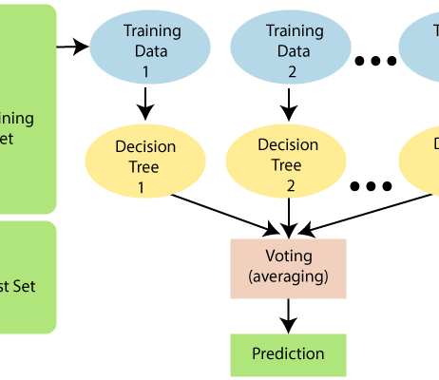
RANDOM FOREST CLASSIFIER
Since the random forest combines multiple trees to predict the class of the dataset, it is possible that some decision trees may predict the correct output, while others may not. But together, all the trees predict the correct output.
Step-1: Select random K data points from the training set.
Step-2: Build the decision trees associated with the selected data points (Subsets).
Step-3: Choose the number N for decision trees that you want to build.
Step-4: Repeat Step 1 & 2.
Step-5: For new data points, find the predictions of each decision tree, and assign the new data points to the category that wins the majority votes

Slide 15

DECISION TREE CLASSIFIER
Decision Tree is a Supervised learning technique that can be used for both classification and Regression problems, but mostly it is preferred for solving Classification problems. It is a tree-structured classifier, where internal nodes represent the features of a dataset, branches represent the decision rules and each leaf node represents the outcome.
In a Decision tree, there are two nodes, which are the Decision Node and Leaf Node. Decision nodes are used to make any decision and have multiple branches, whereas Leaf nodes are the output of those decisions and do not contain any further branches.

Slide 16
LOGISTIC REGRESSION
Logistic regression is one of the most popular Machine Learning algorithms, which comes under the Supervised Learning technique. It is used for predicting the categorical dependent variable using a given set of independent variables.
Logistic regression predicts the output of a categorical dependent variable. Therefore the outcome must be a categorical or discrete value. It can be either Yes or No, 0 or 1, true or False, etc. but instead of giving the exact value as 0 and 1, it gives the probabilistic values which lie between 0 and 1.

Slide 17
Naïve Bayes Classifier Algorithm
Naïve Bayes algorithm is a supervised learning algorithm, which is based on Bayes theorem and used for solving classification problems.
It is mainly used in text classification that includes a high-dimensional training dataset.
Naïve Bayes Classifier is one of the simple and most effective Classification algorithms which helps in building the fast machine learning models that can make quick predictions.

Slide 18
MLP CLASSIFIER
MLP stands for multi-layer perceptron, which is a type of artificial neural network. A neural network is a computer system that is designed to mimic the workings of the human brain.
The MLP classifier is a supervised learning algorithm, which means that it requires a training dataset in order to learn. The training dataset contains input data (x) and output labels (y). The MLP classifier uses the input data to learn how to map the data to the output labels.

Slide 19
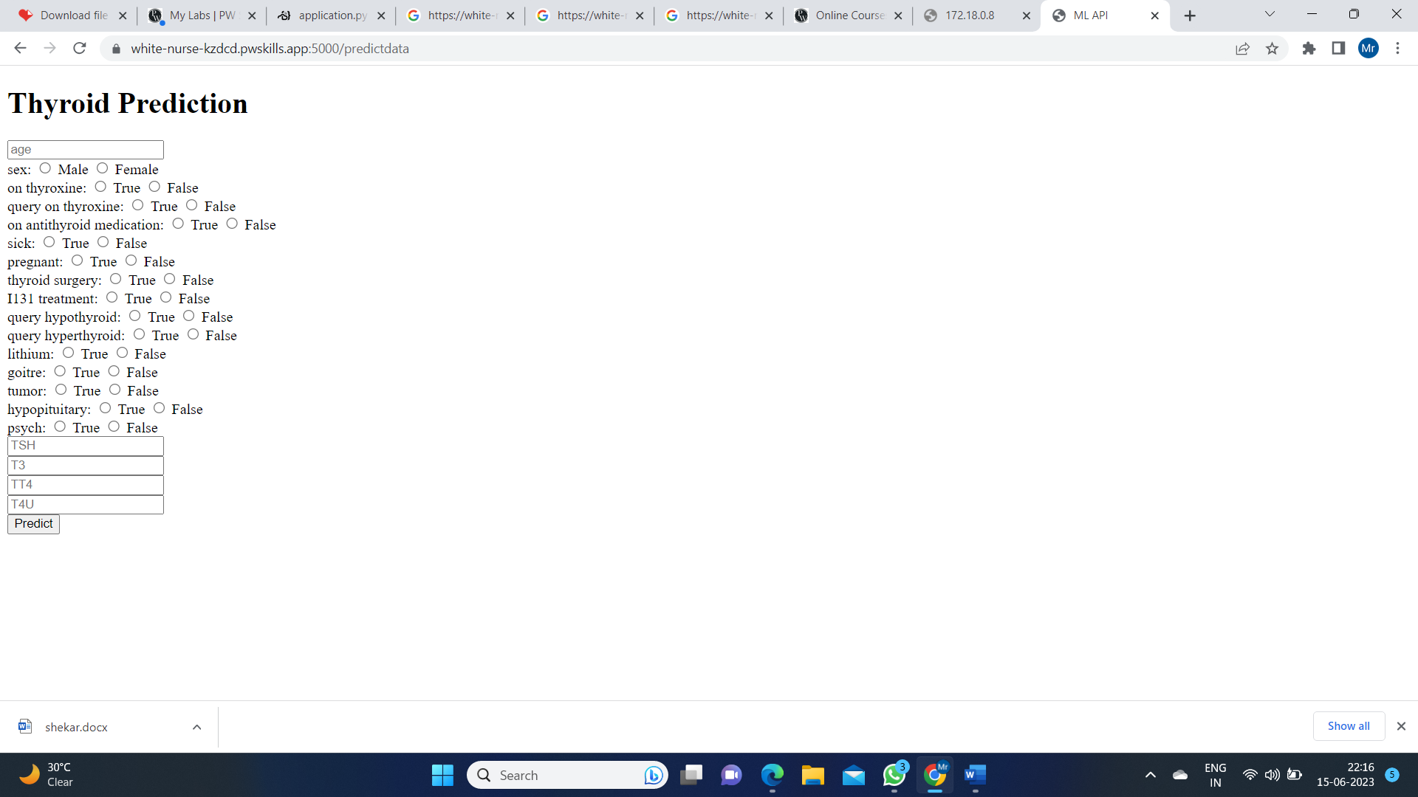
GUI
We have used flask framework to develop graphical user interface

Slide 20
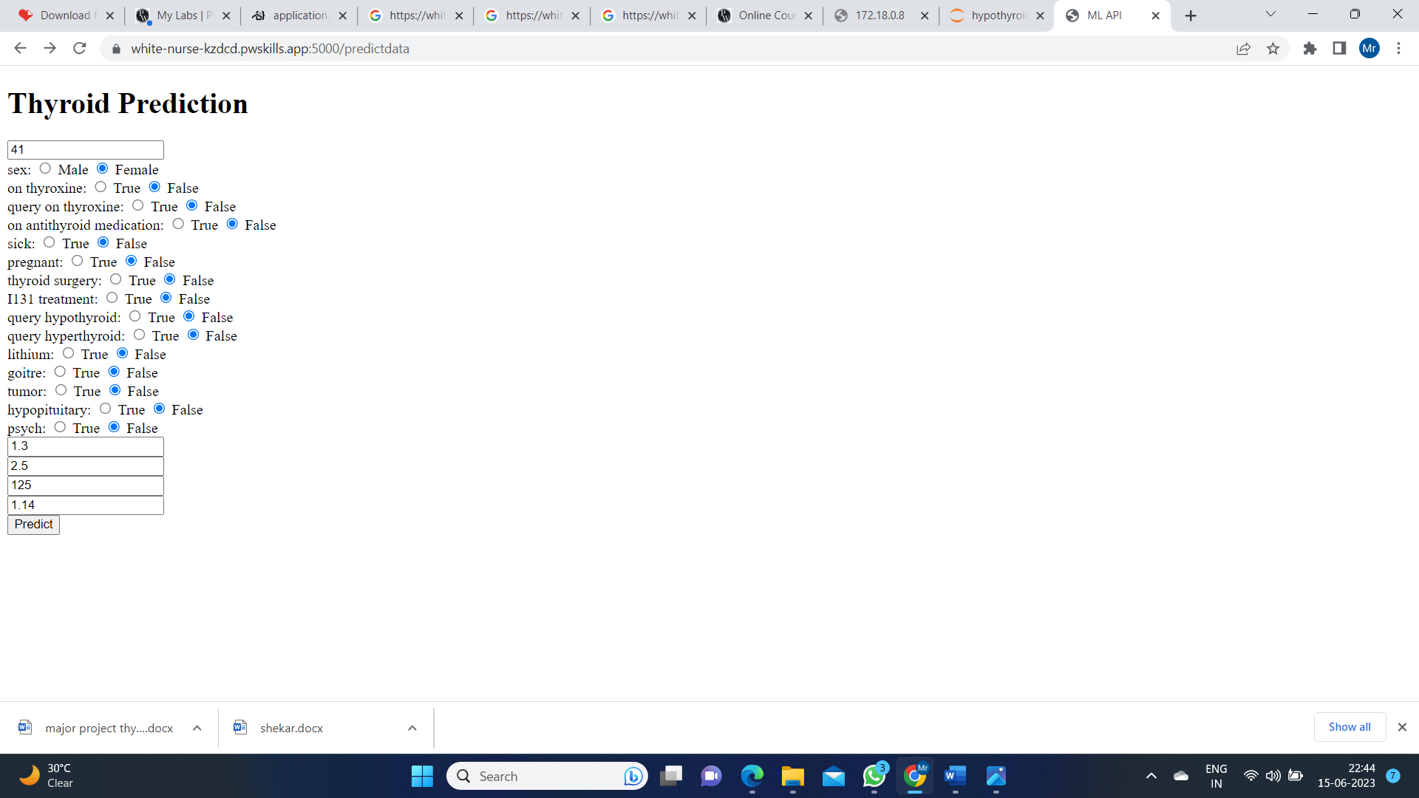
RESULT
ENTERING DATA OF A THYRIOD PATIENT

Slide 21
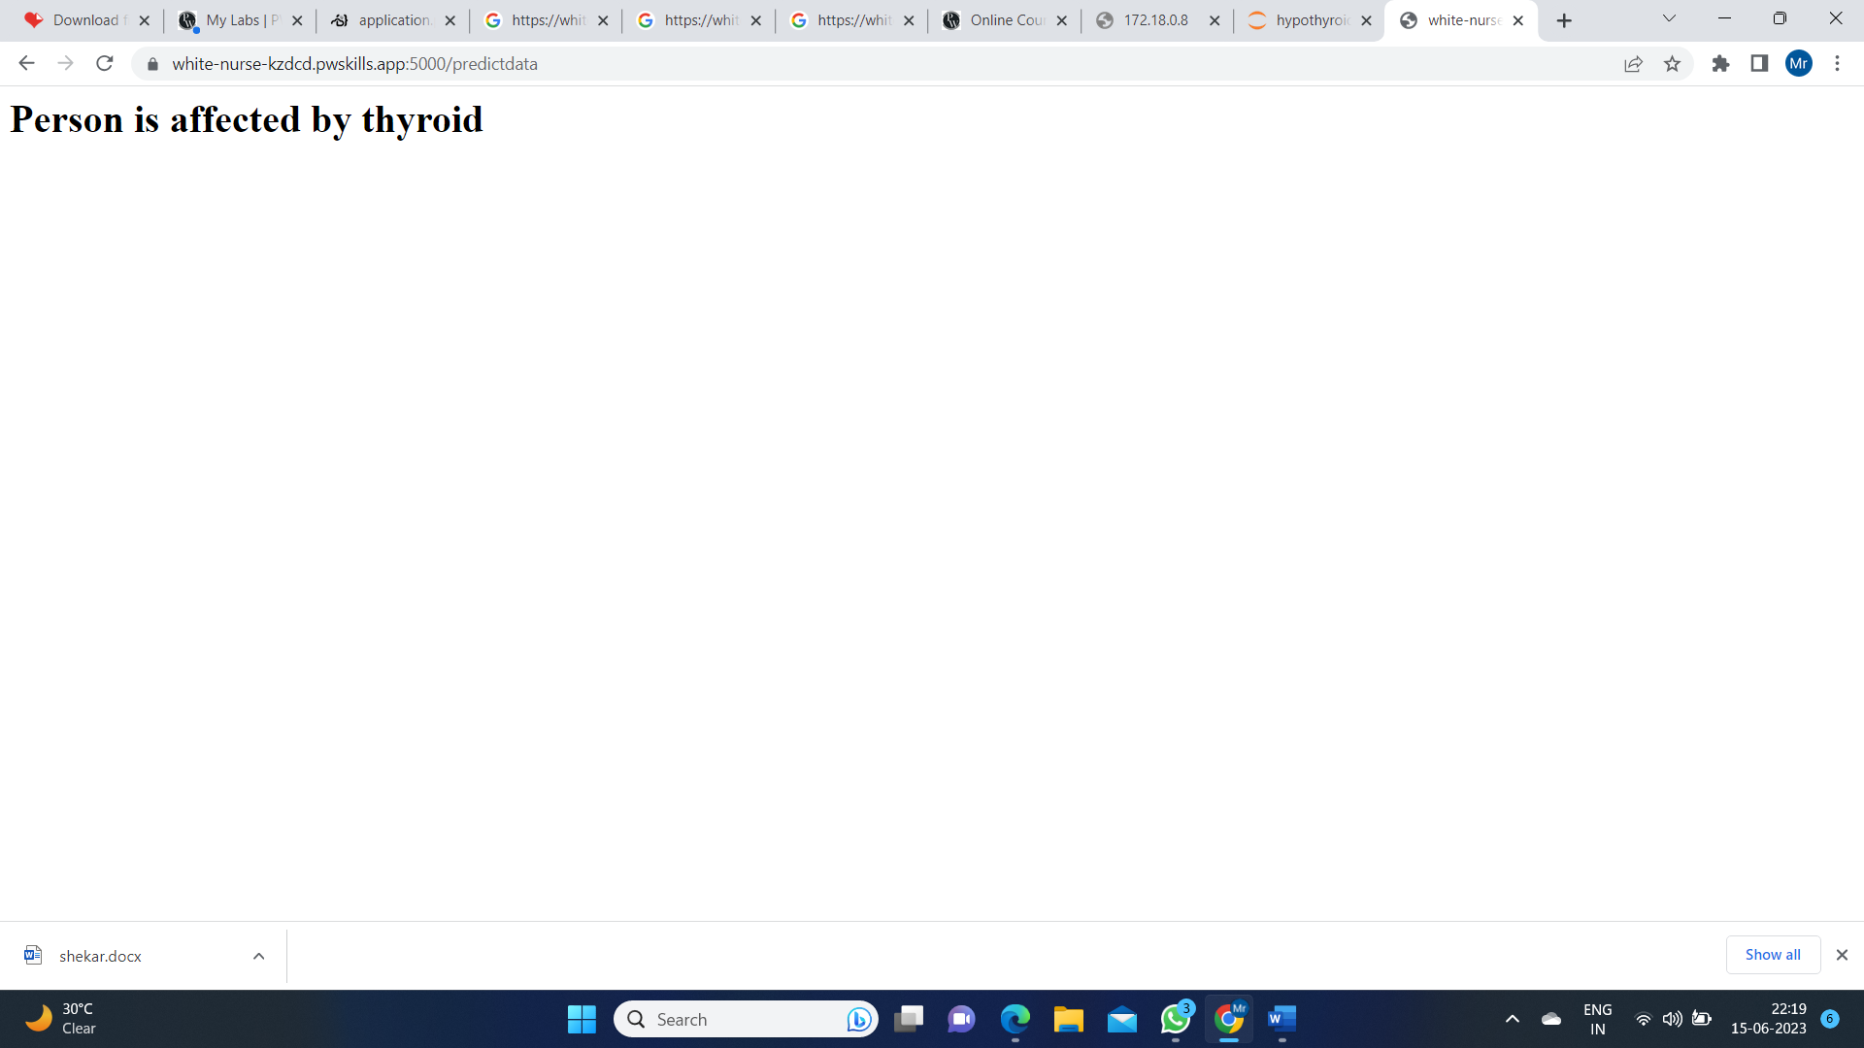
RESULT OF A THYROID PATIENT

Slide 22

ENTERING DATA OF A NON THYROID PATIENT

Slide 23

RESULT OF A NON THYROID PATIENT

Slide 24
CONCLUSION
This Model will be very useful to identify the thyroid disease in a patient using classification-based machine learning techniques. The proposed work will be useful to identify the thyroid disease in a patient using classification-based machine learning techniques. These algorithms give various levels of precision and accuracy.
These methods also aid in decreasing the unwanted redundant data from the patient’s database. The algorithms used in the proposed we are cost effective and also have good output performance and speed. These classification methods make the treatment of the thyroid patient simple by reducing further complex procedures with an affordable price.

Slide 25
FUTURE ENHANCEMENT
There may be chance to work with a larger dataset and We hope that more people from our country will show interest to work on this disease that will help us to find a better solution and able to predict disease in the primary stage with better accuracy. Hope that will help the people of our country to maintain a healthy society.

Slide 26
REFERENCES
Ammulu K. and Venugopal T. “Thyroid Data Prediction using Data Classification Algorithm” IJIRST –International Journal for Innovative Research in Science & Technology| Volume 4 | Issue 2 | July 2017.
2. Ankith Tyagi, Ritika Mehra, Aditya Saxena “Interactive Thyroid Disease Prediction System Using Machine Learning Technique” 5th IEEE International Conference on Parallel, Distributed and Grid Computing (PDGC-2018), 20-22 Dec, 2018, Solan, India.
3. Sunila Godara and Sanjeev Kumar “Prediction of Thyroid Disease Using Machine learning Techniques” International Journal of Electronics Engineering (ISSN: sssssss09737383) Volume 10 ; Issue 2 pp. 787-793 June 2018.
4. Kaggle : https://www.kaggle.com

